Slide 1
A Prophet on the Run The Book of Jonah Overview
The Book of Jonah
March 12,2023

Slide 2
A Prophet on the Run

Slide 3
A Prophet on the Run
Biblical Hermeneutics – the knowledge and interpretation of Scripture
Literal – Seeks to take the plain meaning of the text, or allow the text to speak for itself.
Moral – Seeks to uncover the multiple layers of meaning of the text.
Allegorical – Seeks secondary meanings, the OT is only foreshadowing of NT.
Anagogical – Uses numerical values of letters and words on prophecies and future events and not the actual story.

Slide 4
A Prophet on the Run
2 Kings 14:25
“He restored the border of Israel from the entrance of Hamath as far as the Sea of the Arabah, according to the word of the Lord, the God of Israel, which He spoke through His servant Jonah the son of Amittai, the prophet, who was of Gath-hepher.”
Jonah 1:1
“The word of the LORD came to Jonah the son of Amittai.”

Slide 5
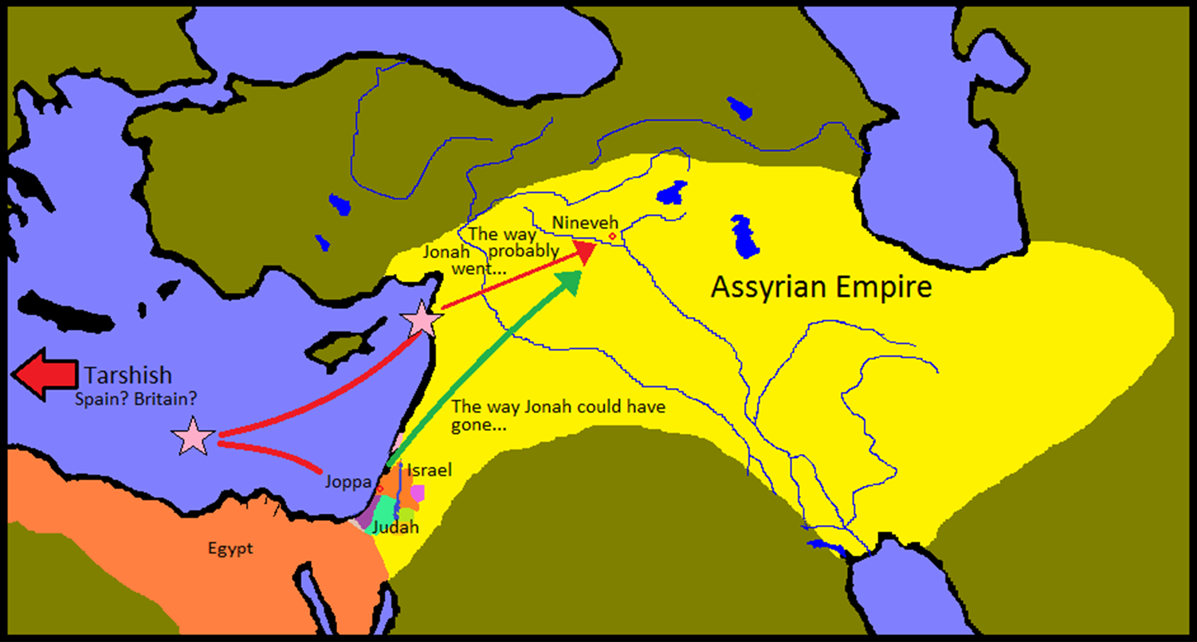
A Prophet on the Run

Slide 6
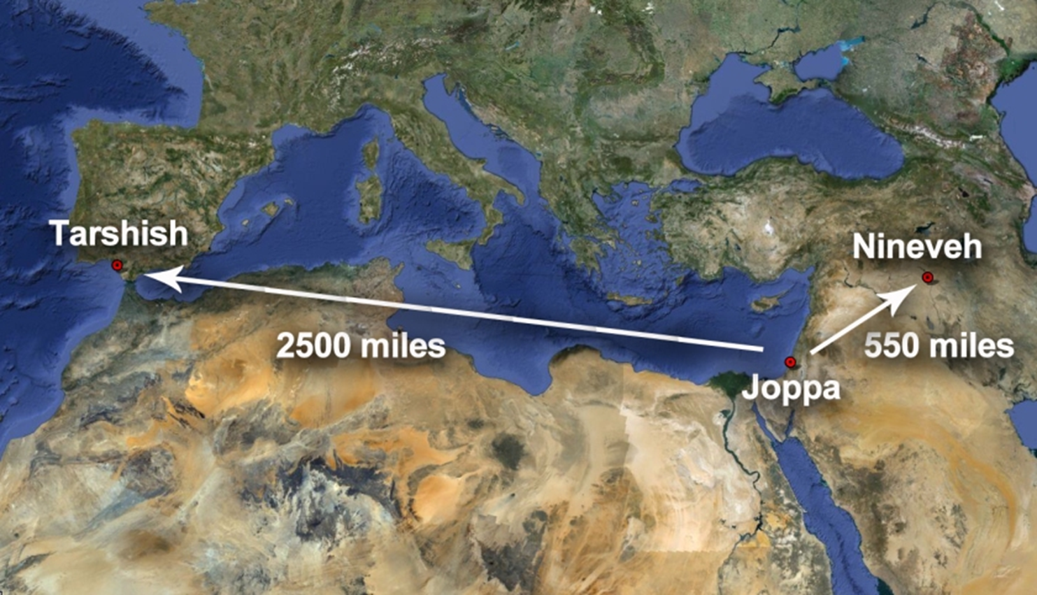
A Prophet on the Run

Slide 7
A Prophet on the Run
I. Sovereign to Send (1:1-17)
A. The Prophet (1:1-3)

Slide 8
A Prophet on the Run
I. Sovereign to Send (1:1-17)
A. The Prophet (1:1-3)
B. The Storm (1:4-16)

Slide 9
A Prophet on the Run
I. Sovereign to Send (1:1-17)
A. The Prophet (1:1-3)
B. The Storm (1:4-16)
C. The Fish (1:17)

Slide 10
A Prophet on the Run
II. Sovereign to Save (2:1-10)
A. The Petition (2:1-4)

Slide 11
A Prophet on the Run
II. Sovereign to Save (2:1-10)
A. The Petition (2:1-4)
B. The Provision (2:5-7)

Slide 12
A Prophet on the Run
II. Sovereign to Save (2:1-10)
A. The Petition (2:1-4)
B. The Provision (2:5-7)
C. The Praise (2:8-10)

Slide 13
A Prophet on the Run
III. Sovereign to Spare (3:1-10)
A. Sent Again (3:1-4)

Slide 14
A Prophet on the Run
III. Sovereign to Spare (3:1-10)
A. Sent Again (3:1-4)
B. Born Again (3:5-9)

Slide 15
A Prophet on the Run
III. Sovereign to Spare (3:1-10)
A. Sent Again (3:1-4)
B. Born Again (3:5-9)
C. Gracious Again (3:10)

Slide 16
A Prophet on the Run
IV. Sovereign to Scold (4:1-11)
A. Grace Given (4:1-4)

Slide 17
A Prophet on the Run
IV. Sovereign to Scold (4:1-11)
A. Grace Given (4:1-4)
B. Grace Taken(4:5-9)

Slide 18
A Prophet on the Run
IV. Sovereign to Scold (4:1-11)
A. Grace Given (4:1-4)
B. Grace Taken(4:5-9)
C. Grace Explained (4:10-11)

Slide 19
A Prophet on the Run
Jonah 4:2
“He prayed to the Lord and said, “Please Lord, was not this what I said while I was still in my own country? Therefore in order to forestall this I fled to Tarshish, for I knew that You are a gracious and compassionate God, slow to anger and abundant in lovingkindness, and one who relents concerning calamity.”

Slide 20
A Prophet on the Run
Nehemiah 9:17
“They refused to listen, and did not remember Your wondrous deeds which You had performed among them; so they became stubborn and appointed a leader to return to their slavery in Egypt. But You are a God of forgiveness, gracious and compassionate, slow to anger and abounding in lovingkindness; and You did not forsake them.”

Slide 21
A Prophet on the Run
Exodus 34:6 “The Lord, the Lord God, compassionate and gracious, slow to anger, and abounding in lovingkindness and truth.”
Psalm 145:8 “The Lord is gracious and merciful; slow to anger and great in lovingkindness.”
Lamentations 3:22-23 “²² The Lord’s lovingkindnesses indeed never cease, for His compassions never fail. ²³ They are new every morning; great is Your faithfulness.”

Slide 22
A Prophet on the Run
Nahum 1:3 “The Lord is slow to anger and great in power, and the Lord will by no means leave the guilty unpunished. In whirlwind and storm is His way, and clouds are the dust beneath His feet.
Joel 2:13 “And rend your heart and not your garments. Now return to the Lord your God, for He is gracious and compassionate, slow to anger, abounding in lovingkindness and relenting of evil.”

Slide 23
A Prophet on the Run The Book of Jonah Overview
The Book of Jonah
March 12,2023

